Slide 1


LLM Reading Group 3:
Autonomous Agents
Presented by
Bassel Al Omari

Slide 2

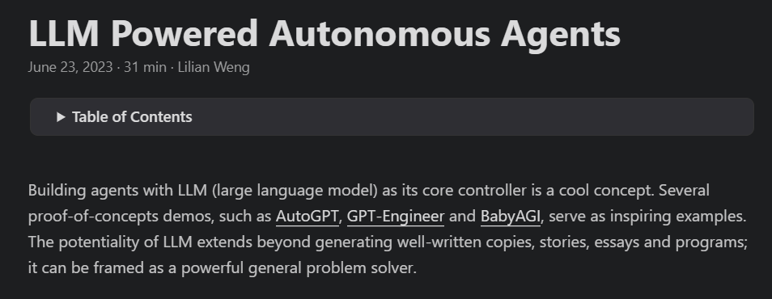
Blog Post Link

Slide 3
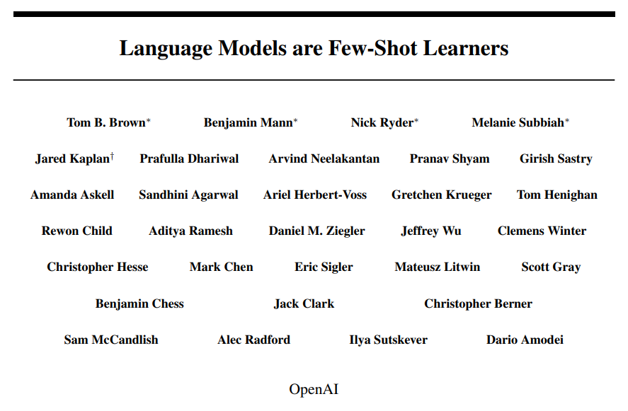
Context
Language models show excellent few-shot performance
Few-shot: Given task description and a few examples, model can perform task
Prompt:
Translate English to Arabic
Machine Learning → التعلم الآلي
Red Cat → قطة حمراء
Angry Goose →

Slide 4
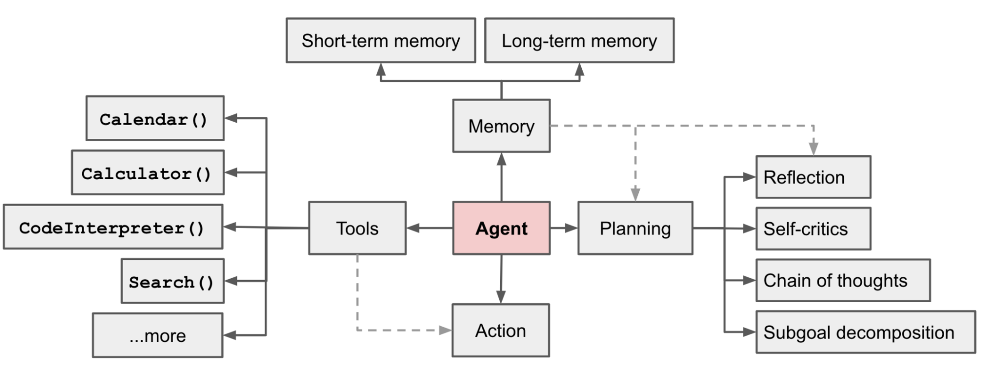
LLM Agent System

Slide 5
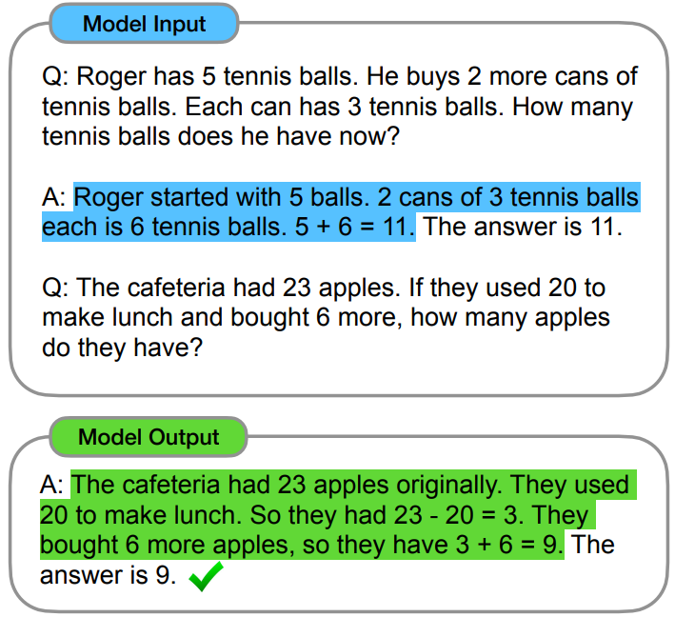
Planning
Explicit Thinking
Forcing the model to explain its thought process yields better results
Chain of Thought
(Wei et al. 2022)
ReAct
(Yao et al. 2023)
Before asking the language model to perform an action, ask it to explicitly communicate any thoughts and reflections

Slide 6
Planning
Planning Systems
Forcing model to reflect and judge previous actions yields better results
Tree of Thought
(Yao et al. 2023)
Tree-based search of reasoning trajectory
Reflexion
(Shinn et al. 2023)
Reinforcement learning setup but with language models sprinkled in
Input
Next Action
Actor
LLM
Environment
Reflection
Self-Reflection
LLM
Output
Observation + Reward

Slide 7




Tool Use
Language models can call on assisting APIs to fetch information
Toolformers
(Schick et al. 2023)
Allow LM to suggest possible API calls
Test whether API calls help model performance
Fine tune model on text with embedded API calls that are helpful

Slide 8
Memory
Vector Databases
Store previous encounter in database
Previous encounters are indexed by their features
Index represents coordinates in vector space
When in new encounter, query previous encounters with closest coordinates, and augment results in output
Memory 2
Memory 3
New Encounter
Memory 1

Slide 9
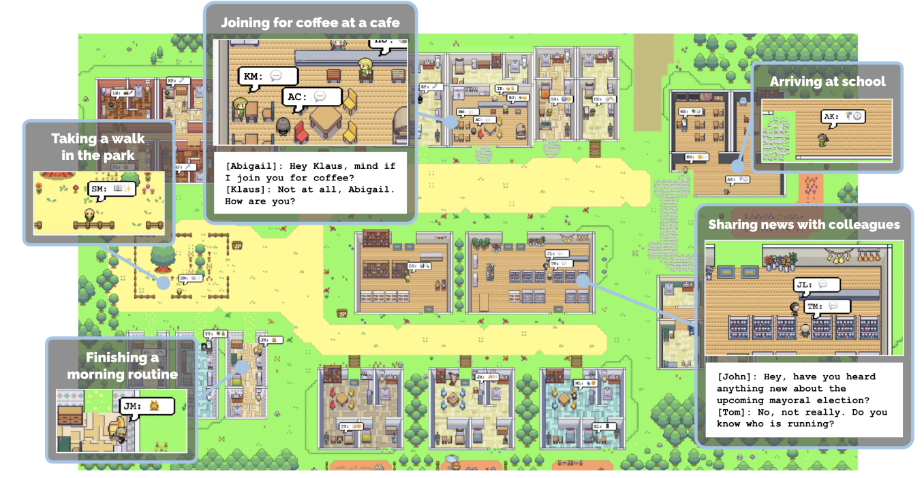


Look Ahead
LLM Video Game Agents
Demo Link
LLM-based Researchers/Programmers

